Slide 1

BY AK

Slide 2
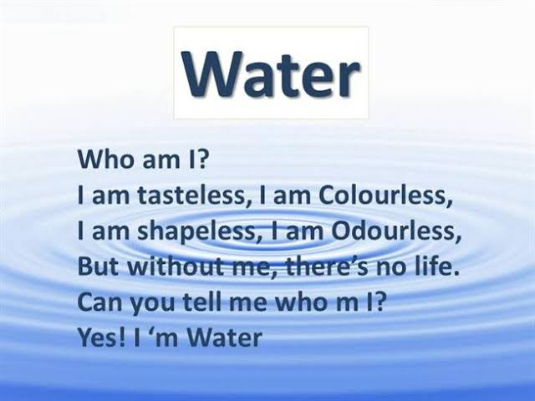
AK

